Slide 1
Trustee Award 2016

Slide 2
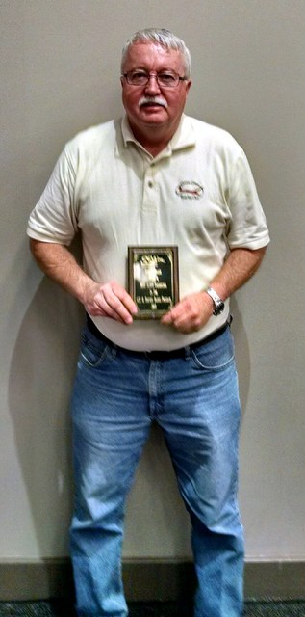
Bob Miller
Award at SSA Convention for most flight training activity in our region.

Slide 3
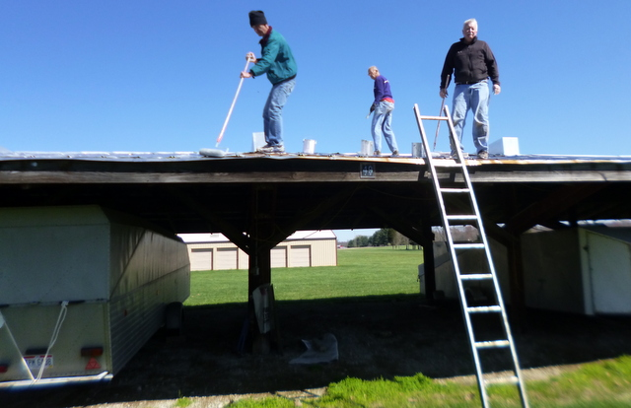
Maintenance of buildings & grounds
Bob has provided leadership in the full range of maintenance efforts to keep our buildings properly maintained and our grounds looking great.

Slide 4
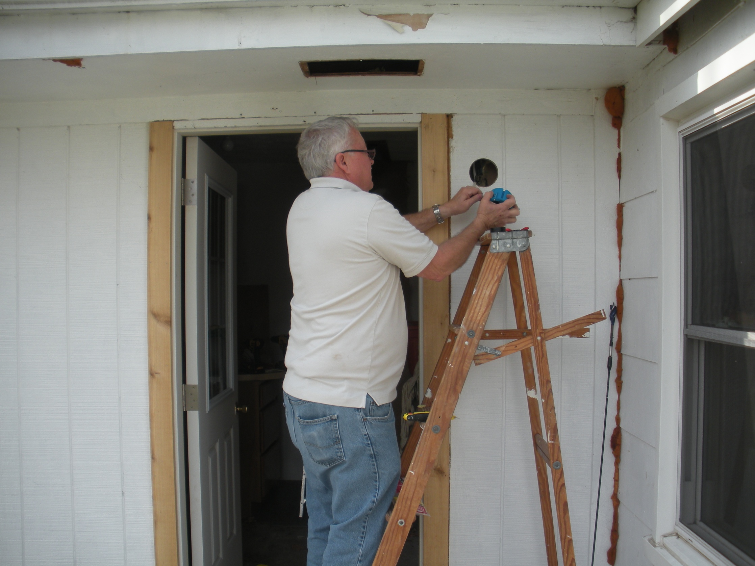
Maintenance of the farmhouse electrical system has been part of Bob’ activitees

Slide 5
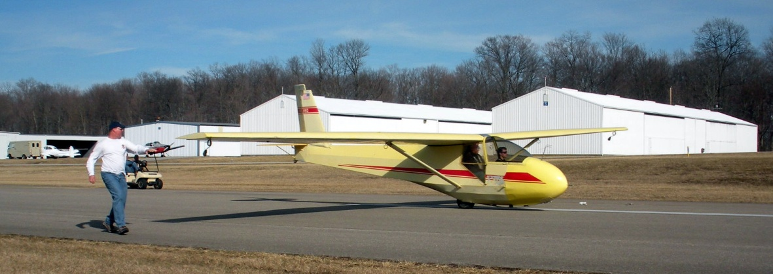
Key to operations at Clinton County, including this 4th Sunday in which Bob’s participation enabled 15 flights to be enjoyed.
Photo: Chandler Beckwith and Bob Miller commence takeoff roll at Clinton Cty, providing training and experience with communications with powered aircraft operating at the same field, accuracy landings in a light cross wind, etc.

Slide 6
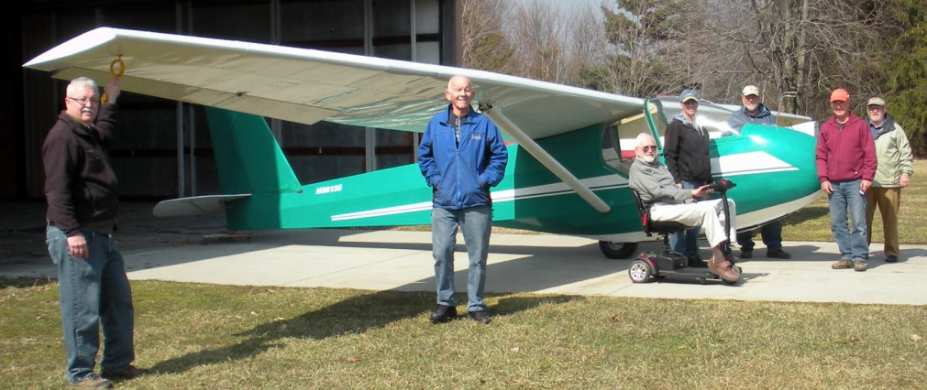
Active member of Wednesday Crew, including flight instruction, tow plane operation and assembly of club aircraft.

Slide 7
Designated Pilot Examiner
Bob Miller completed a year - long process and received the official
Designation as a Pilot Examiner (DPE).
Mike Puehler, the FAA Chief Examiner, came to CCSC and
observed the oral and flight portions of Bob's first practical test (which resulted in Tom Geygan receiving his private glider rating). At the conclusion of the test Mike provided his signature giving
Bob authority to conduct Practical Tests for Private, Commercial and Flight Instructor privileges in
gliders

Slide 8
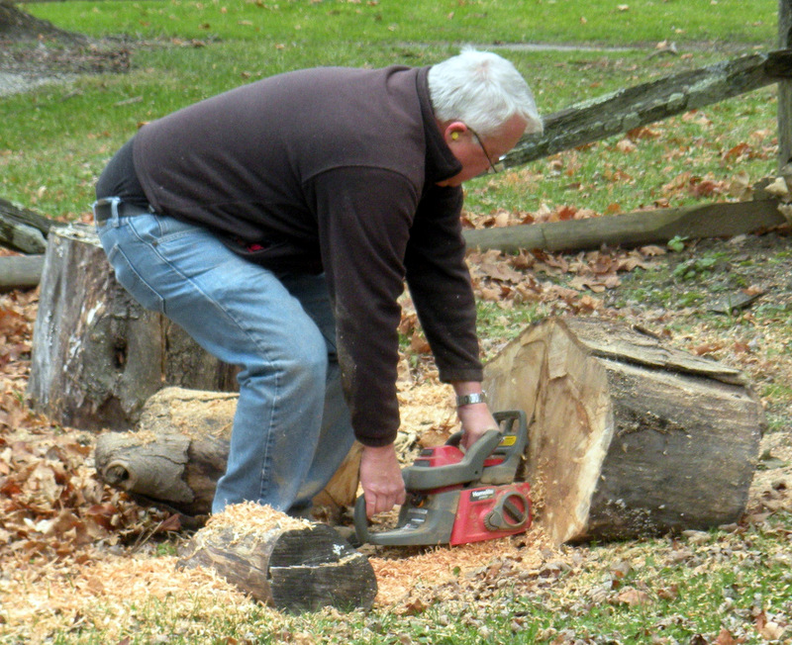
Firewood control
Bob kept the chain saws running and led the teams that took down trees that needed to be removed. His personal contribution to the firewood supply was important to keeping the clubhouse comfortable all winter.

Slide 9
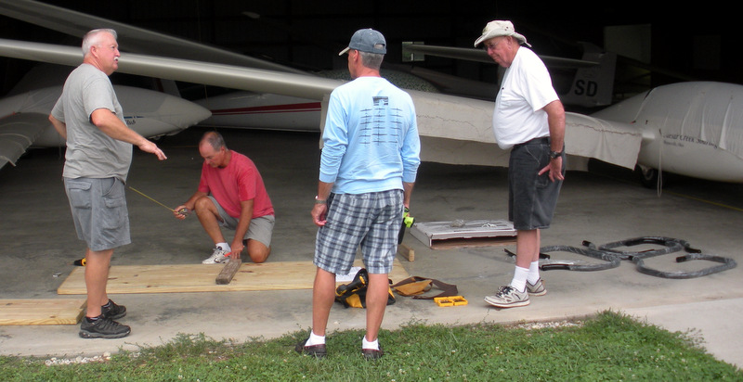
Wednesday Crew Projects
Bob has led the Wednesday Crew in construction and painting new picnic tables for the launch areas, and many other projects to enhance the operational efficiency and safety at our facility as well as protecting and preserving our infrastructure.

