Slide 1
2019 CCSC Annual Banquet
Opening Comments
Organization
Capital Project History
Plans for 2019
OLC
Weekend at Bernies
Awards

Slide 2
Reason to Celebrate
NO DEBT – mortgage paid off 20 years ago
Top 3 clubs in the country
Glider Fleet is very diverse
Membership continues to be very strong in spite of the economy
Everyone in the club has something to offer

Slide 3
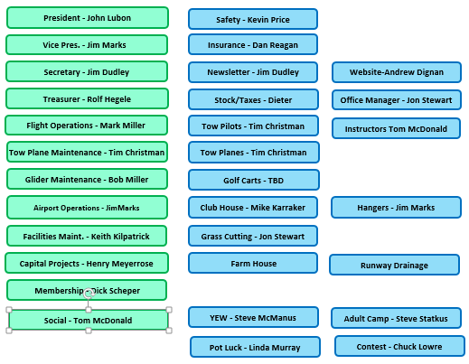
CCSC Organization

Slide 4
Special Duties
Safety Officer - Kevin Price
Weekly Frequent Flyer – Jim Dudley
Insurance – Dan Reagan
Taxes – Dieter Schmidt
Computer Support – Andrew Dignan
Wood Splitting Consultant – Keith Kilpatrick

Slide 5
Special Events
Ferrari Event – Maury Drummey
3rd Saturday Potluck - Linda Murray
Youth Camp – Steve McManus
Adult Camp – Steve Statkus
Air Force – Kevin Price
2019 Sports Class Nationals – Chuck Lohre

Slide 6
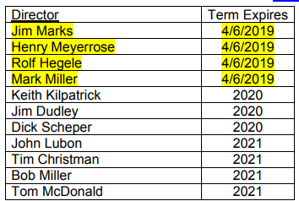
Elections
4 Positions are available for election
Ballots will go out in March
Elections Saturday April 6, 2019

Slide 7
Plane Captains
TRY NOT TO BREAK IT!!
Towplane – Tony Bonser
Towplane – Bob Miller
Towplane - Tim Morris
Glider ASK21 CC – John Lubon
Glider ASK21 SD – Rolf Hegele
Glider Grob 103 – Open
Glider Grob 102 – Andrew Dignan
Schweitzer 2-33 – Keith Kilpatrick
Schweitzer 2-33 – Steve Statkus
Schweitzer 2-33 - Maurizio

Slide 8
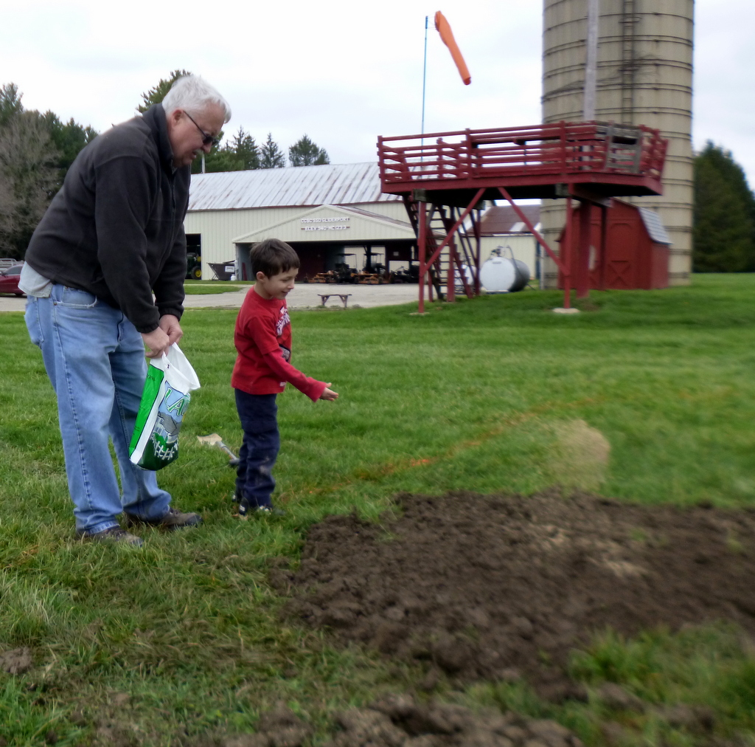
CCSC Facility Project List
Keith Kilpatrick
Runway Repairs
Pond Cleanup
Wood Splitting

Slide 9
Plans for 2019
33Z Engine Repair
Barn Roof Replace or Paint
Runway Repairs – on going

Slide 10
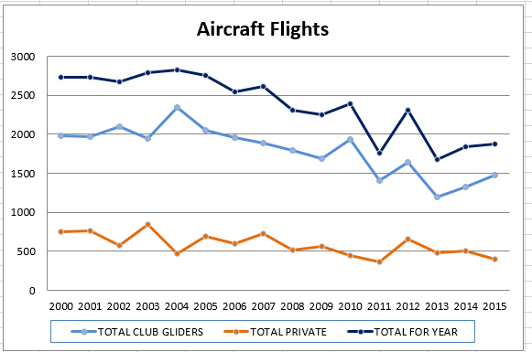

Slide 11
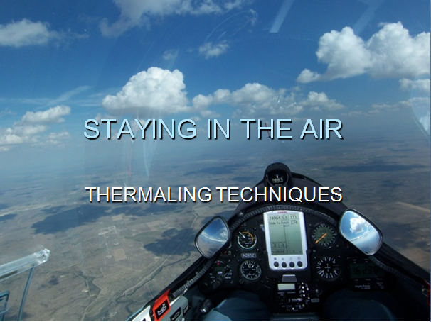
ON LINE CONTEST

Slide 12
ON LINE CONTEST
Worldwide – 14,000 Pilots
North America – 1400 Pilots
Region 5 In,Ky,Mi,Oh – 62 Pilots
1400 Clubs participate World Wide

Slide 13

CCSC ON LINE CONTEST
CCSC pilots flew enough miles to circle the earth!!
  19 Pilots
  171 Flights
  46,000 km

Slide 14
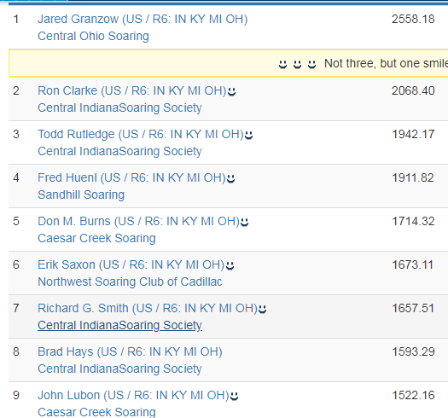
Region 6 OLC

Slide 15
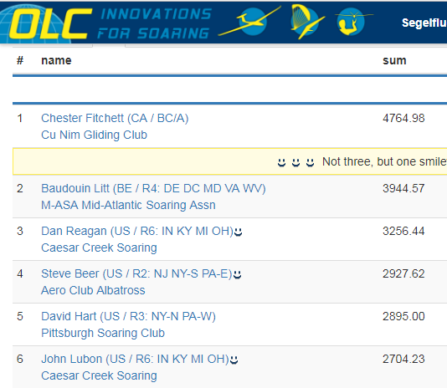
OLC 2019

Slide 16
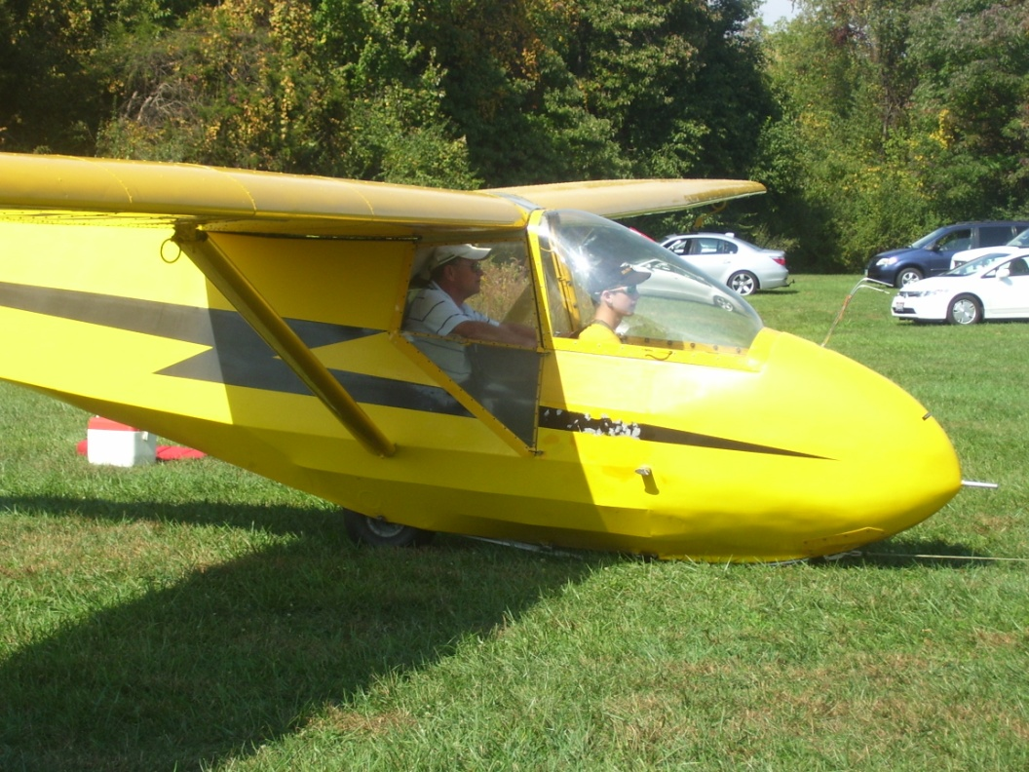
Club Awards
Top Youth 2018:
Booker Atkins
Ethan Maxwell - 26 Flights
Micah Ferguson – 24 Flights

Slide 17
Tow Pilots
PLEASE TRY TO STAY BEHIND ME !!
1st Sat - John Armor, CR Gillespie
1st Sun - Norb Mauer, Dieter Schmidt, Andy Swanson
2nd Sat – Brian Mork, Haskell Simpkins
2nd Sun - Jim Goebel, Lorrie Penner, Gorden Penner
3rd Sat - Don Green, Steve McManus, Dick Scheper
3rd Sun - Tony Bonser, Tim Christman
4th Sat - Guy Byars, Larry Kirkbride
4th Sun - Ron Blume, Tim Morris

Slide 18
Club Awards
Tow Pilot of 2018:
2nd Place Dieter Schmidt– 145 flts
3rd Place – Haskell Simpkins– 109 flts

Slide 19
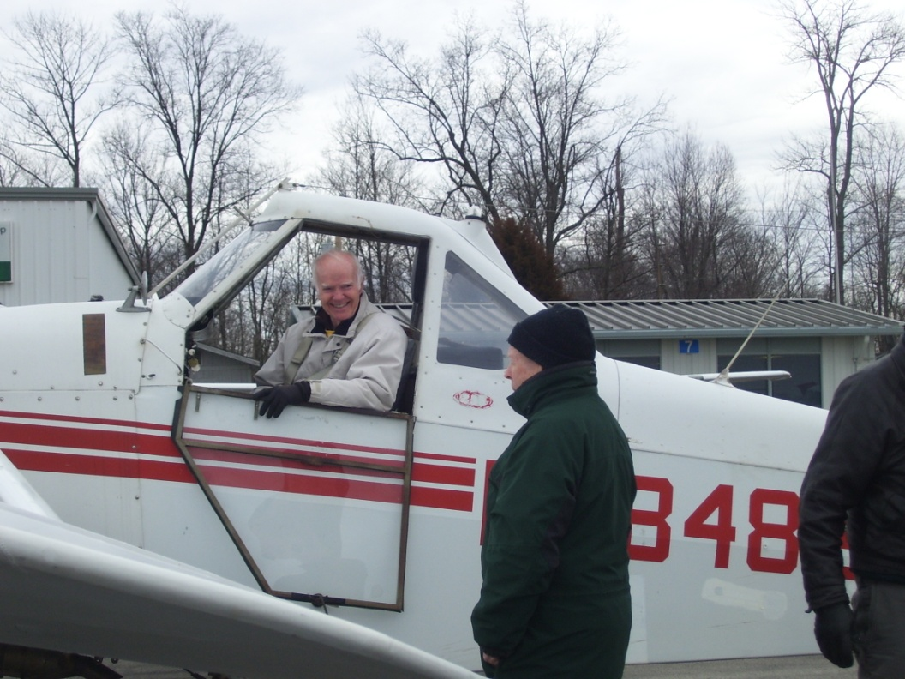
Club Awards
Tow Pilot of 2018:
Don Green – 282 flts

Slide 20
New Ratings in 2018
SAMI RINTALA Instructor Reinstatement
ANDREW SWANSON Instructor Reinstatement
MANFRED MAURER Instructor Reinstatement
TOM LEPEY New Flight Instructor
JOSEPH JAAP Private Pilot Glider
OTIS LEWIS Private Pilot Glider
AL QUINN Commercial Pilot Glider
BILL HALL Private Pilot Glider
MARK HANLON Private Pilot Glider
DAN REAGAN Commercial Pilot Glider
ERAN MOSCONA Commercial Pilot Glider
DANIEL KATUZIENSKI Private Pilot Glider

Slide 21
Instructors
IF YOU DON”T SCARE ME, I MAY LET YOU KEEP FLYING
1st Sat - Paul McClaskey, Tom McDonald
1st Sun - Bob Miller, Manfred Maurer
2nd Sat – Bob Anderson, Bill Gabbard
2nd Sun - Jim Goebel, Tom McDonald, Tom Rudolf
3rd Sat - Charlie DeBerry, Sami Rintala
3rd Sun - Dick Eckels, Zach Seifker
4th Sat - John Atkins, Joe Jackson, Larry Kirkbride
4th Sun - John Lubon, Kat McManus

Slide 22
Club Awards
Instructor of 2018:
2nd Place Zack Siefker– 64 flights
3rd Place Bob Anderson– 63 flights

Slide 23
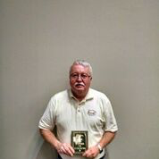
Club Awards
Instructor of 2018:
Bob Miller – 153 flights

Slide 24
Club Awards
Most Flights:
2nd Place - Otis Lewis– 51 flights
3rd Place - Mark Hanlon– 45 flights

Slide 25
Club Awards
Most Flights 2018
Booker Atkins
52 Flights

Slide 26
Crew Chiefs
THERE IS NO NORMAL OPERATION !!
1st Sat - Steve Fenstermaker
1st Sun - Mike Karraker
2nd Sat - Dick Holzwarth
2nd Sun - Dave Menchen
3rd Sat - Maury Drummey
3rd Sun – Brian Stoops
4th Sat - Chuck Lohre
4th Sun - Steve Statkus

Slide 27
Club Awards
Crew of 2018:
2nd Place - 2nd Sunday 170 Launches
3rd Place – 3rd Sunday 167 Launches

Slide 28
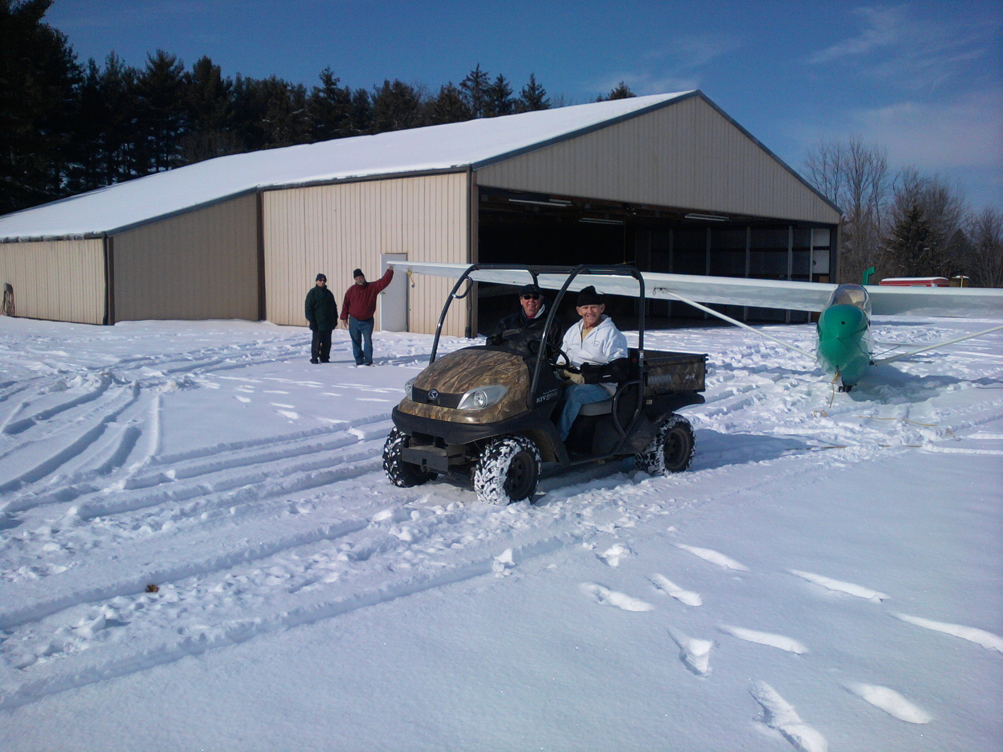
Club Awards – Crew of the Year 2018
1st Place 1st Sunday 187 Launches

Slide 29
Previous Trustee Awards
1981 Bruce Helvey – Runway
1982 Pat DeNaples – Business
1983 Clair Crook – Social
1984 Bill Maxwell – Tricubs
1985 Tom Best
1986 Mary DeNaples
1987 Bob Hawley
1988 Rick Glass – Tow Planes
1989 Phil Corn – Tow Planes

Slide 30
Previous Trustee Awards
1990 Guy Byars – Scoring Program Runway
1991 Jim Oquin – Instuctor
1992 – Henry Meyerrose – Club Infrastrure
1993 Linda Scheiman – SSA Convention, RTKH
1994 Bob Root – Crew Chief
1995 John Antrim – Tow Planes
1996 Tom Bales – Instructor, Myrtle Beach
1997 Kent Sorrell – The Chef
1998 Mel Williams – Examiner, Legal Counsil
1999 Creg Crook – Clubhouse Expansion

Slide 31
Previous Trustee Awards
2000 Bob Root
2001 Jim Jurst - Writer, Instructor
2002 Jim Miceli – Business Leader
2003 John Lubon – Projects

Slide 32
Previous Trustee Awards
Jim Dudley – Secretary, Newsletter
2017 Bob Miller – Examiner, Instructor
2018 – Tim Christman

Slide 33
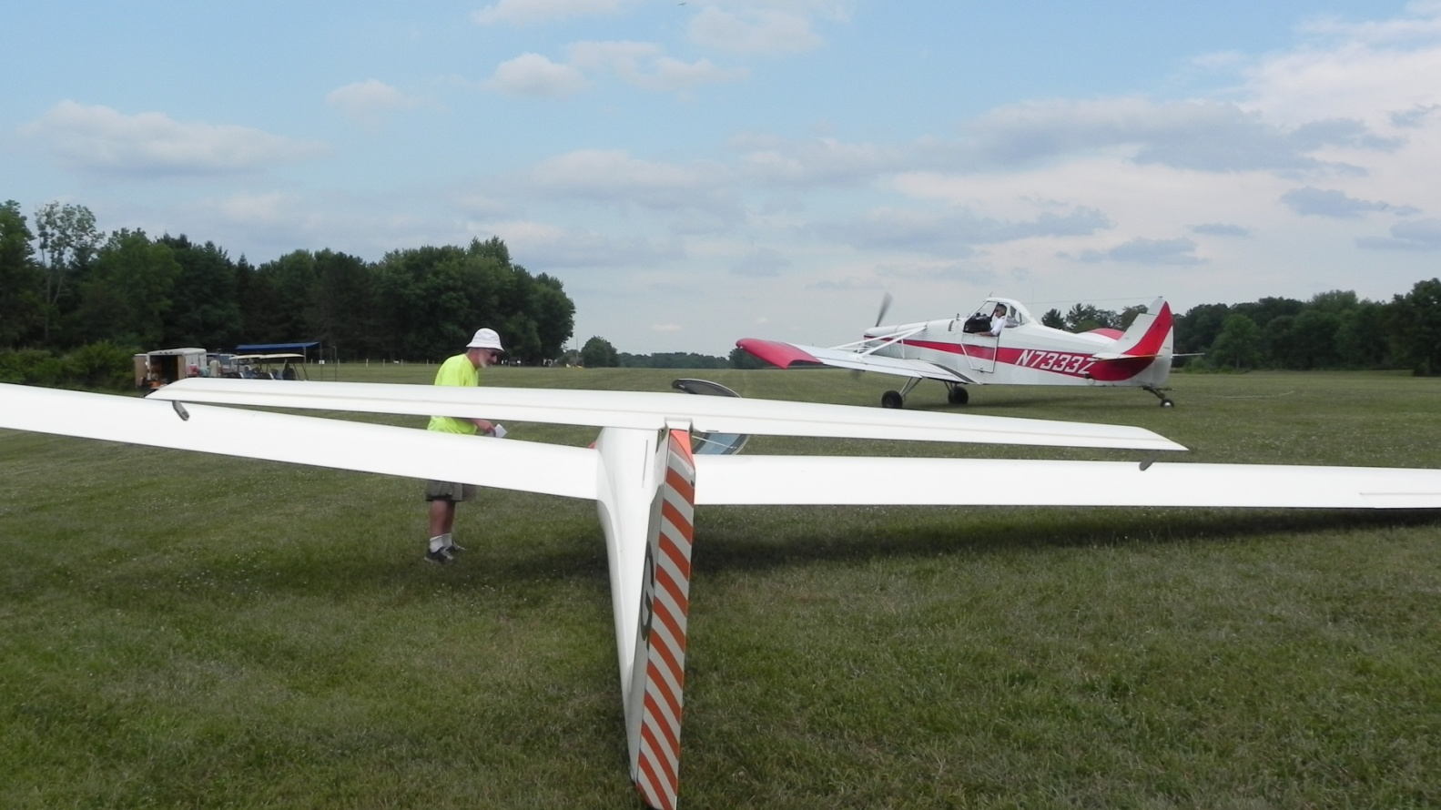
Trustee Award
2018 Award Presentation

Slide 34
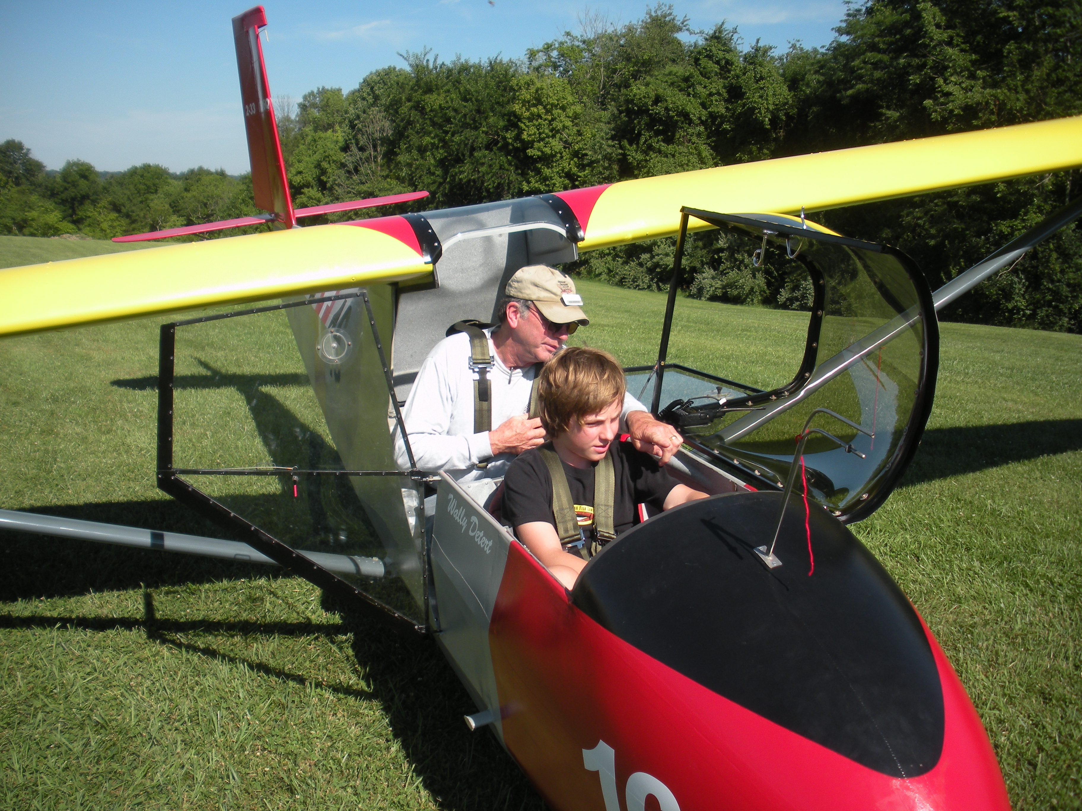
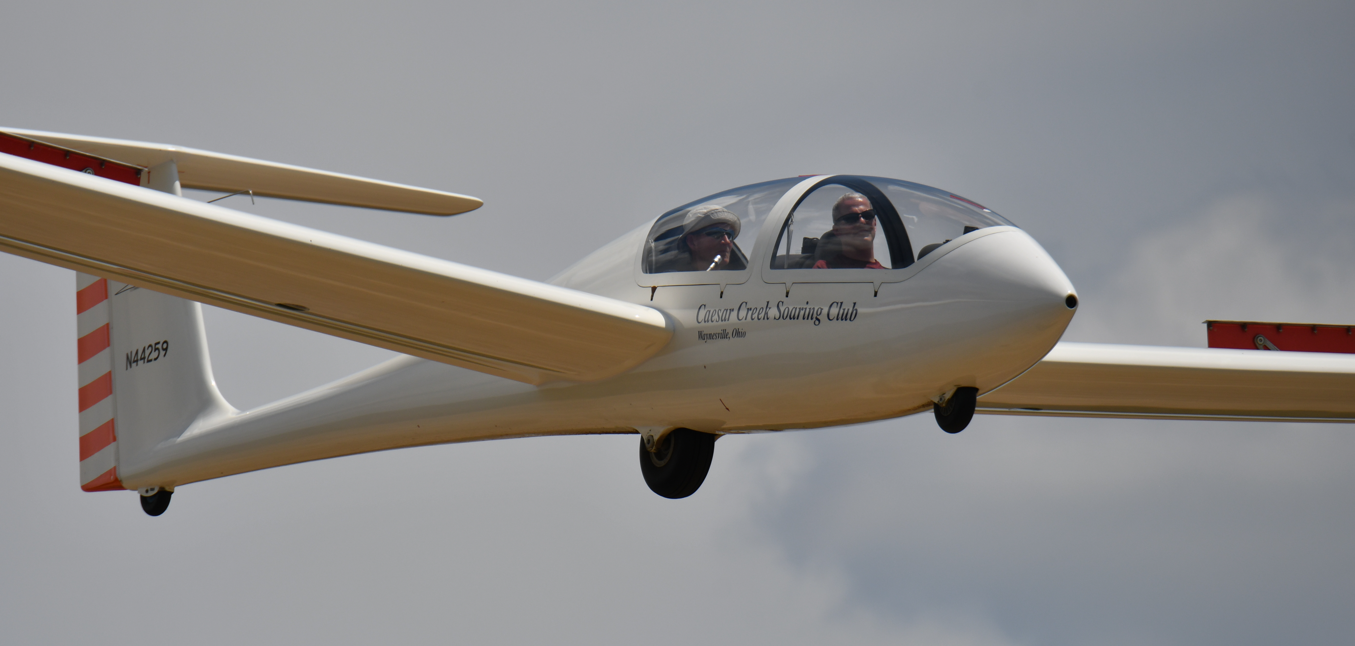
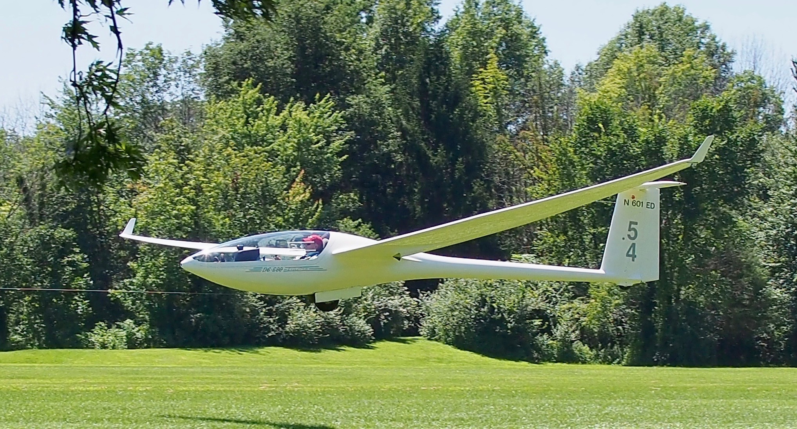
Lets Go Fly

